Slide 1
Washington State Girls’ Basketball Coaches Association 4th Annual Hall of Fame Banquet.

Slide 2
Thank you to our sponsors

Slide 3
Thank you to our sponsors

Slide 4
Thank you to our sponsors

Slide 5
Thank you to our sponsors

Slide 6
Thank you to our sponsors

Slide 7
Thank you to our sponsors

Slide 8
Thank you to our Sponsors

Slide 9
Thank you to our sponsors

Slide 10
Thank you to our sponsors

Slide 11
Thank you to our sponsors

Slide 12
Thank you to our sponsors
Blanchet Booster Club

Slide 13
Thank you to our sponsors

Slide 14
Our 2019 Washington State Girls Basketball Coaches Association Inductees

Slide 15
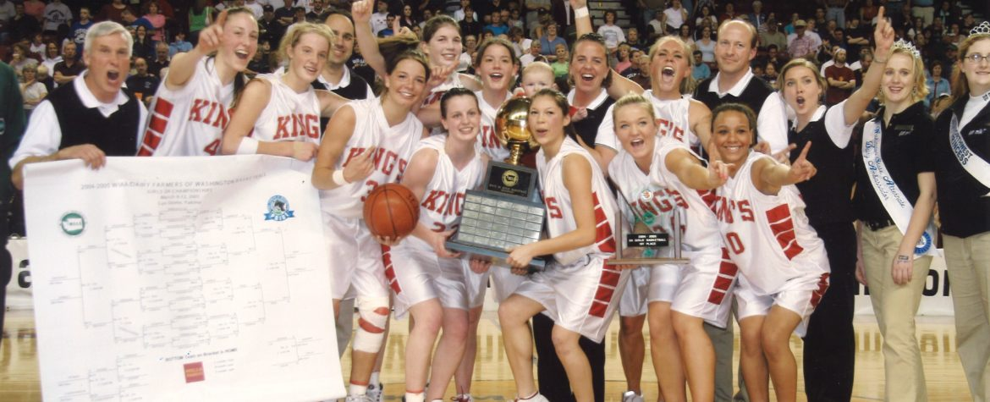
Eric Rasmussen

Slide 16
Scott Sandsberry

Slide 17
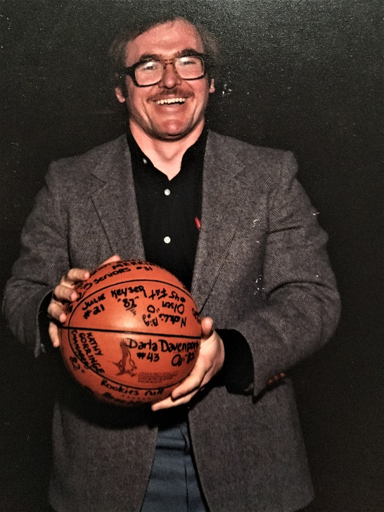
Paul Dretsch

Slide 18
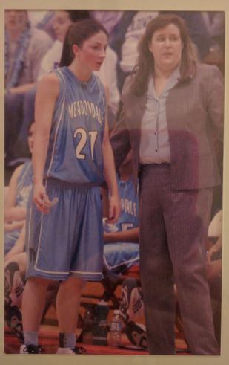
Karen Blair

Slide 19
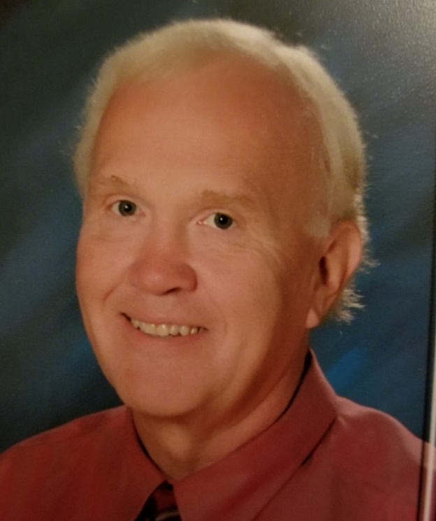
Steve Berg

Slide 20
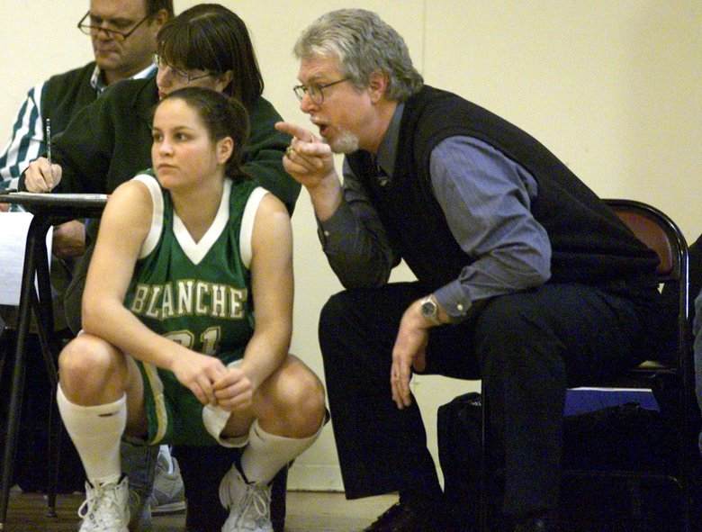
Terry Wilkinson

